Slide 1
ABV Effect on Beer Ratings
Moonsoo Kim, Saurabh Pattarkine, Ben Michaels

Slide 2
Introduction
Research Question: How does the level of alcohol content (ABV) in beer influence its overall consumer review scores?
In 2022, the U.S. beer market was valued at $115 billion, with a significant 6% growth in craft beer.
Despite a decline in overall beer consumption, craft beer's market share and production are on the rise.
Beer rating apps have shown to impact sales, with a positive correlation between ratings and sale prices.
Objective: To analyze the impact of ABV (Alcohol by Volume) on consumer beer ratings.

Slide 3


Data and Methodology
Data Origin: “Data sourced from Kaggle's 'Beer Profile and Rating Set', including Beer Tasting Profiles Dataset by sp1222 and 1.5 Million Beer Reviews by Tanya Cashorali.”
Observation Units: "Analysis focuses on unique beers, with information on ABV, style, brewery, and consumer ratings.“
Key Variables:
- Independent Variable (X): ABV of beer.
- Dependent Variable (Y): Overall consumer review score.
Sampling Method: "A 30% subsample was used for exploration and model building. The rest, totaling 2238 beers, formed the basis for our statistics.“
ABV Threshold: "Excluded beers with ABVs over 15% due to brewing constraints and different processes required for high ABV beers."

Slide 4
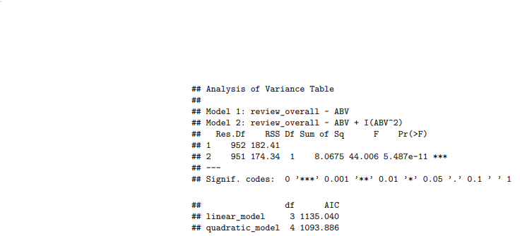
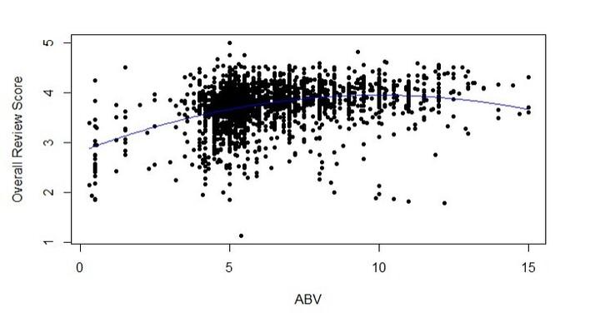
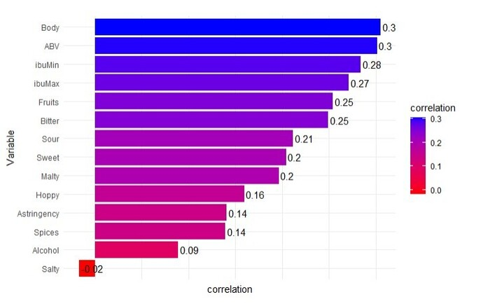
Visual Analysis
ABV vs Overall Review
Correlation Analysis
Comparative Model Analysis

Slide 5
ABV vs Overall Review
Notes:
Observation: Reviews increase with ABV up to about 10%, then decline at higher ABVs.
Derived Variable: ABVSquared introduced for analysis.
Graph here illustrates the relationship between ABV and overall review scores.
Notice the trend: as ABV increases, reviews improve, peaking around 10%, and then start to decrease for higher ABV values.
To analyze this non-linear trend, we introduced a derived variable, ABVSquared.

Slide 6
Correlation with Overall Review
Notes:
Correlation Analysis: Examines relationships between variables and review scores.
In Figure 2, we present the correlation between various variables and overall review scores, offering insights into their relationships.

Slide 7
Model Comparison using ANOVA and AIC
Notes:
The ANOVA and AIC (Akaike Information Criterion) will help you statistically compare the two models.
A significant p-value in the ANOVA would suggest that the quadratic model has a statistically better fit than the linear model.
A lower AIC value for the quadratic model would suggest it is a better fit in terms of the trade-off between goodness of fit and model complexity.

Slide 8
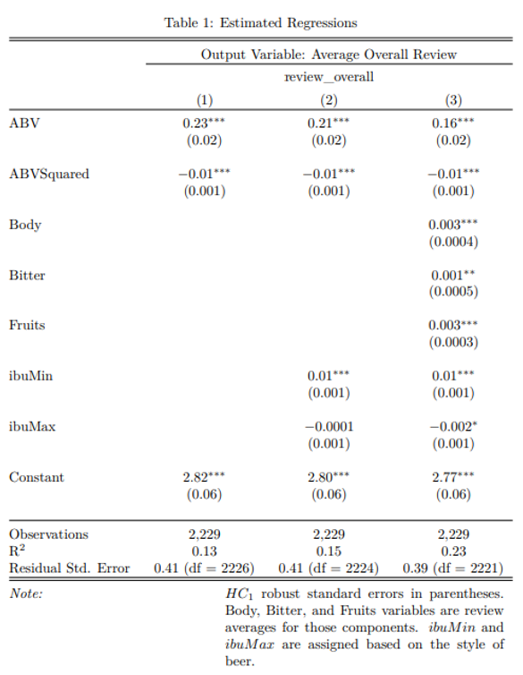
Results and
Analysis
Notes:
Content:
Key Findings: ABV significantly impacts consumer ratings.
R² Improvement: More variables lead to better model accuracy.
Practical Implications: Predicted ratings for different ABV levels.
In Table, we see the results of our regression analysis. ABV was found to be highly significant in all models, and the R² value increased with the addition of more variables. For example, with our basic model, beers with ABVs of 4, 9, and 15 percent are expected to have average ratings of 3.57, 4.08, and 4.02, respectively.

Slide 9
Limitations
Potential geographic clustering effects.
Influence of prior reviews and time-based effects of ethanol.
Need for updated data reflecting current trends.
Omitted variables like marketing, bottle design, hype, or tradition.

Slide 10
Conclusion
To conclude, our study demonstrates a clear relationship between ABV and consumer ratings in the beer market.
These insights are invaluable for breweries, offering guidance for product development and market strategy.
As we move forward, further research considering our study's limitations and exploring new variables will be essential in this dynamic market.

Slide 11
Thanks !

